Slide 1
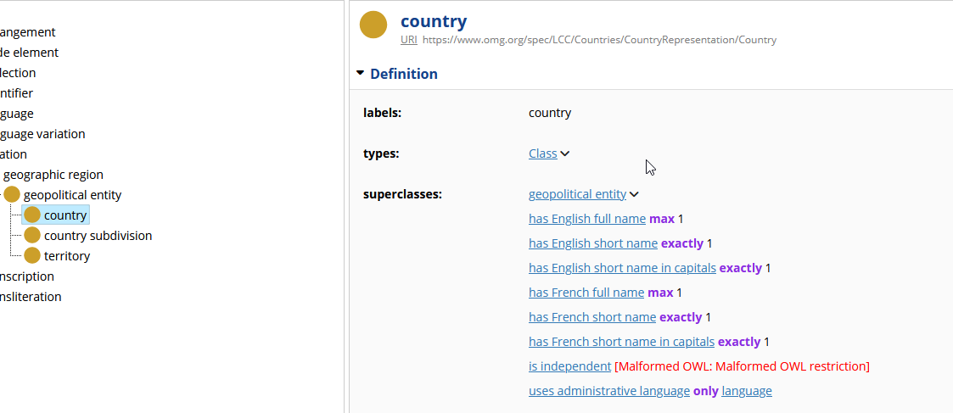

Slide 2
Protégé
[ rdf:type owl:Restriction ;
owl:onProperty lcc-cr:isIndependent ;
owl:qualifiedCardinality "1"^^xsd:nonNegativeInteger ;
owl:onDataRange xsd:boolean
] ,
Top Braid Composer
rdfs:subClassOf [
a owl:Restriction ;
owl:onDataRange xsd:boolean ;
owl:onProperty lcc-cr:isIndependent ;
owl:qualifiedCardinality 1 ;
] ;

